Slide 1
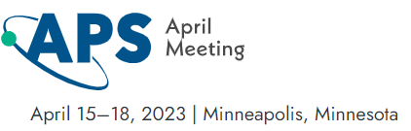
Simulations of Electron Detection Systematic Errors for a UCNA+ Experiment
Rashika Gupta
Date : April 16, 2023
APS – April 2023 meet
email : rashika.gupta@uky.du

Slide 2
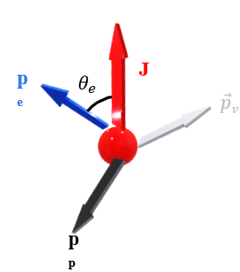
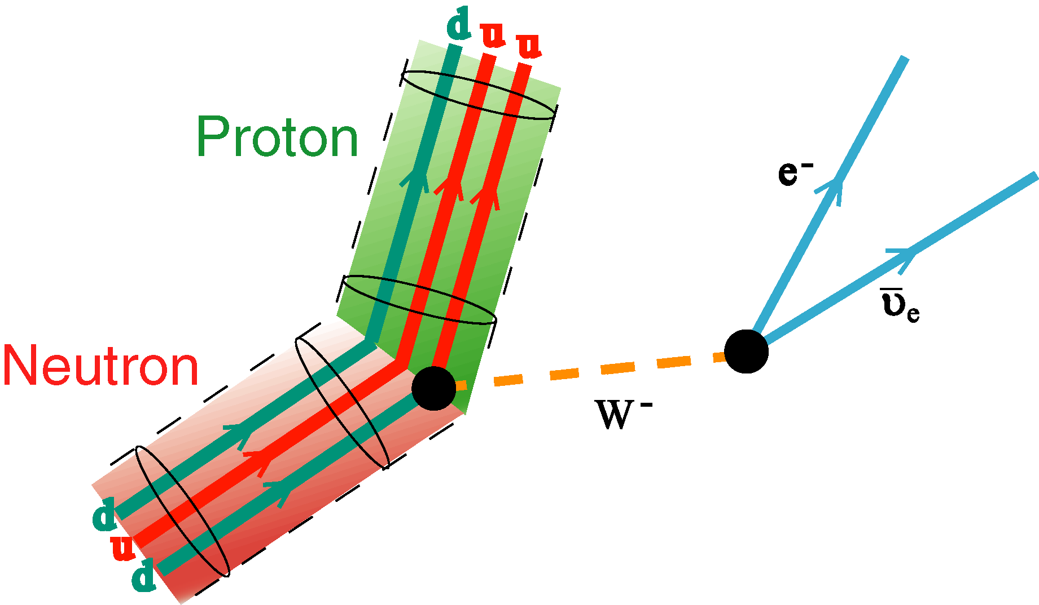
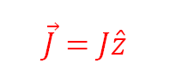
Angular Correlations
$$\vec{J}=J\hat{z}$$
APS April 2023 R.Gupta 1

Slide 3
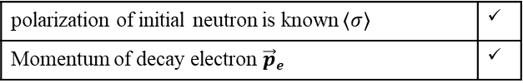
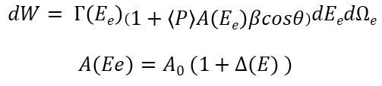
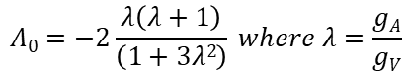
Angular Correlations
polarization of initial neutron is known $\left\langle σ\right\rangle$ | ✓
Momentum of decay electron $\vec{p}e$ | ✓
$$\vec{J}=J\hat{z}$$
$$dW= Γ\left(Ee\right)\left(1+\left\langle P\right\rangle A\left(Ee\right)βcosθ\right)dEedΩe$$
$A(Ee)=A0 (1+Δ(E) )$
$$A0=−2\frac{λ\left(λ+1\right)}{\left(1+3λ2\right)} where λ=\frac{gA}{gV}$$
1
APS April 2023 R.Gupta 2

Slide 4
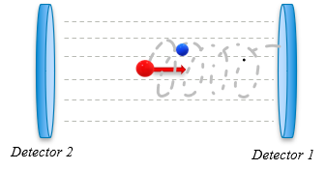
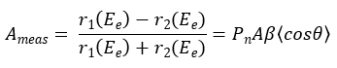
Angular Correlations
polarization of initial neutron is known $\left\langle σ\right\rangle$ | ✓
Momentum of decay electron $\vec{p}e$ | ✓
$$\vec{J}=J\hat{z}$$
$$dW= Γ\left(Ee\right)\left(1+\left\langle P\right\rangle A\left(Ee\right)βcosθ\right)dEedΩe$$
$A(Ee)=A0 (1+Δ(E) )$
$$A0=−2\frac{λ\left(λ+1\right)}{\left(1+3λ2\right)} where λ=\frac{gA}{gV}$$
1
APS April 2023 R.Gupta 2

Slide 5
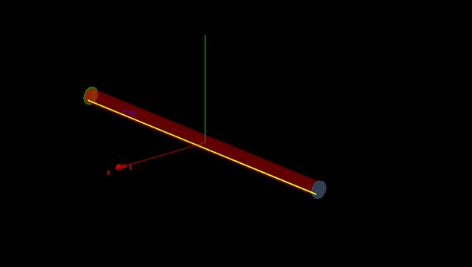
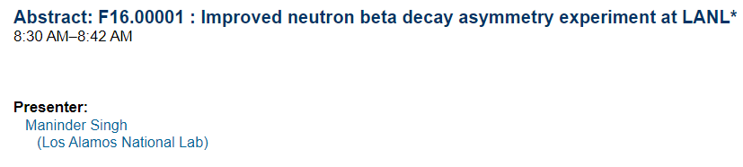

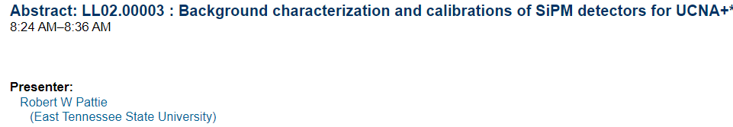
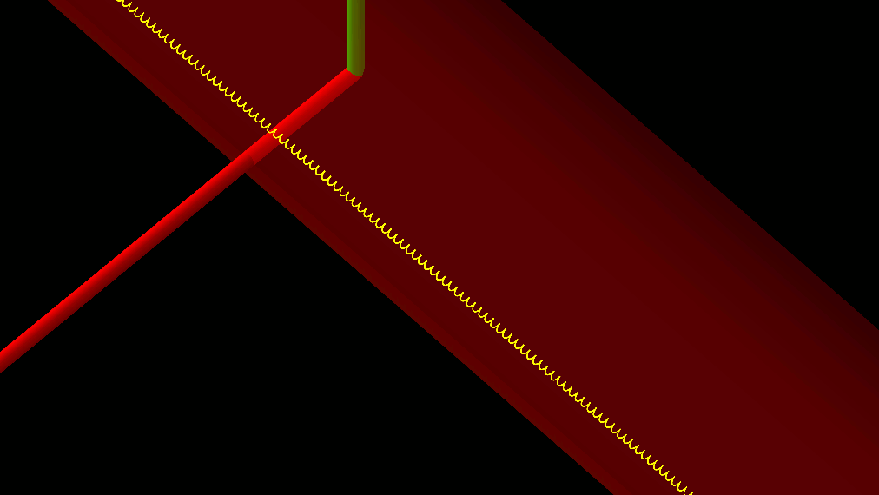
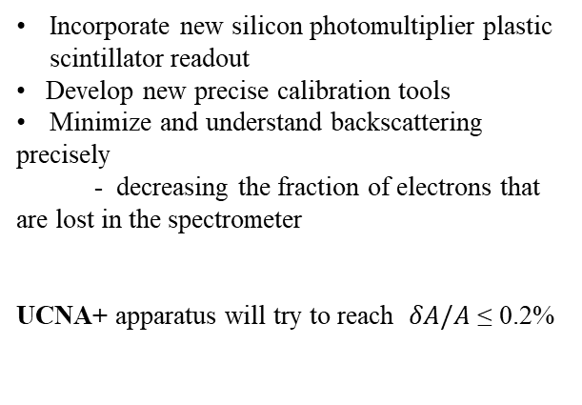
From UCNA to UCNA +
Incorporate new silicon photomultiplier plastic scintillator readout
• Develop new precise calibration tools
Minimize and understand backscattering
precisely
- decreasing the fraction of electrons that are lost in the spectrometer
UCNA+ apparatus will try to reach $δA/A$ ≤ 0.2%
Fig : Geant4 simulations representation for UCNA+ experiment
3
APS April 2023 R.Gupta 3

Slide 6
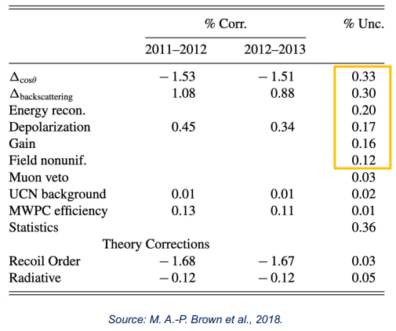
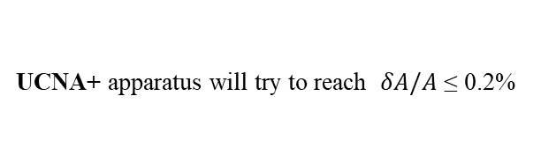
From UCNA to UCNA +
UCNA+
Back-scattering correction to less than 10 %
Model different geometries
Direct measurements
Time of flight method
Fractional changes in the back-scattering
UCNA+ apparatus will try to reach $δA/A$ ≤ 0.2%
Fig : Geant4 simulations representation for UCNA+ experiment
3
APS April 2023 R.Gupta 4
Notes:
0.2 % to match the pereko III precision and which would be pretty close.
ERROR BUDGET : in UCNA there was significant back-scattering. Need to model very precisely. Aimining for below 10% for the back-scattering correction.

Slide 7
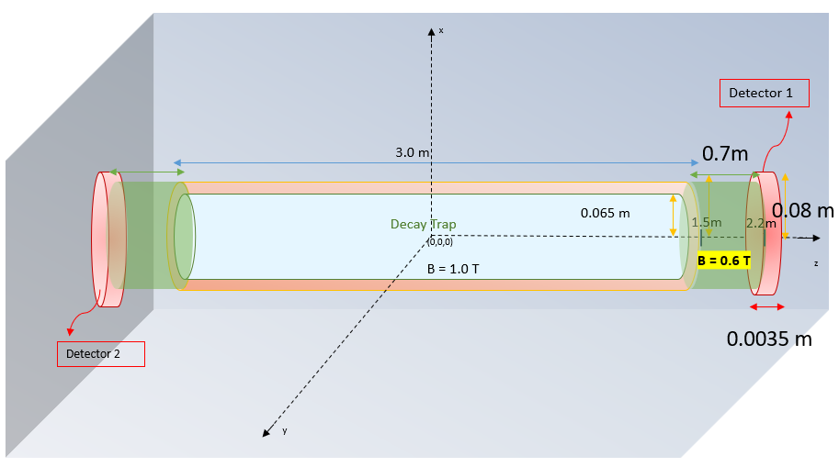
UCNA + Geant4 setup
No MWPC as in UCNA
Fig : Geant4 simulations representation for base setup of UCNA+ experiment
Fig : Geant4 simulations representation for base setup of UCNA+ experiment
4
APS April 2023 R.Gupta 5
Notes:
This is the base setup
Check how the magentic field lines would look like

Slide 8
Different configurations for scattering measurements
Endcap foils
- uniform field region
- field expansion region
Source holder foils
- Mylar of 0.5-micron thickness
- 6F-6F 0f 120 nm thickness,
- Graphite
Fig : Geant4 simulations representation for base setup of UCNA+ experiment
APS April 2023 R.Gupta 6

Slide 9

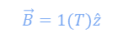


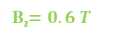
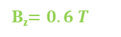


Different configurations for scattering measurements
Endcap foils
- uniform field region
- field expansion region
Source holder foils
- Mylar of 0.5-micron thickness
- 6F-6F 0f 120 nm thickness,
- Graphite
B_{z}$=0.6 T$
$$\vec{B}=1(T)\hat{z}$$
B_{z}$=0.6 T$
B_{z}$=0.6 T$
$$\vec{B}=1(T)\hat{z}$$
B_{z}$=0.6 T$
0- Foil
1- Foil
Foils :
sixFsixF (made of H, C, N, O, F) with fractional mass of (0.27g,0.48g,0.027g,0.054g,0.16g) of 130 nm thickness
Be coating of 120 nm thickness
B_{z}$=0.6 T$
$$\vec{B}=1(T)\hat{z}$$
B_{z}$=0.6 T$
2- Foil
Fig : Geant4 simulations representation for UCNA+ experiment when there are 0, 1 and 2 foils respectively
placed in front of the detector at +z direction.
APS April 2023 R.Gupta 7

Slide 10

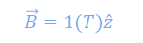
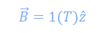
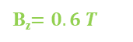
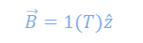
Different configurations for scattering measurements
Endcap foils
- uniform field region
- field expansion region
Source holder foils
- Mylar of 0.5-micron thickness
- 6F-6F 0f 120 nm thickness,
- Graphite
B_{z}$=0.6 T$
$$\vec{B}=1(T)\hat{z}$$
B_{z}$=0.6 T$
B_{z}$=0.6 T$
$$\vec{B}=1(T)\hat{z}$$
B_{z}$=0.6 T$
1- Foil
0- Foil
B_{z}$=0.6 T$
$$\vec{B}=1(T)\hat{z}$$
B_{z}$=0.6 T$
2- Foil
Fig : Geant4 simulations representation for UCNA+ experiment when there are 0, 1 and 2 foils respectively placed in front of the detector at +z direction with the source holder at the center made of mylar of thickness 0.5 micron.
APS April 2023 R.Gupta 8

Slide 11


Different configurations for scattering measurements
Endcap foils
- uniform field region
- field expansion region
Source holder foils
- Mylar of 0.5-micron thickness
- 6F-6F 0f 120 nm thickness,
- Graphite
B_{z}$=0.6 T$
$$\vec{B}=1(T)\hat{z}$$
B_{z}$=0.6 T$
B_{z}$=0.6 T$
$$\vec{B}=1(T)\hat{z}$$
B_{z}$=0.6 T$
0- Foil
1- Foil
B_{z}$=0.6 T$
$$\vec{B}=1(T)\hat{z}$$
B_{z}$=0.6 T$
2- Foil
Fig : Geant4 simulations representation for UCNA+ experiment when there are 0, 1 and 2 foils respectively placed in front of the detector at +z direction. with the source holder at the center made of sixFsixF of thickness 120 nm.
APS April 2023 R.Gupta 9
Notes:
Get sixFsixfmaterial compositon

Slide 12
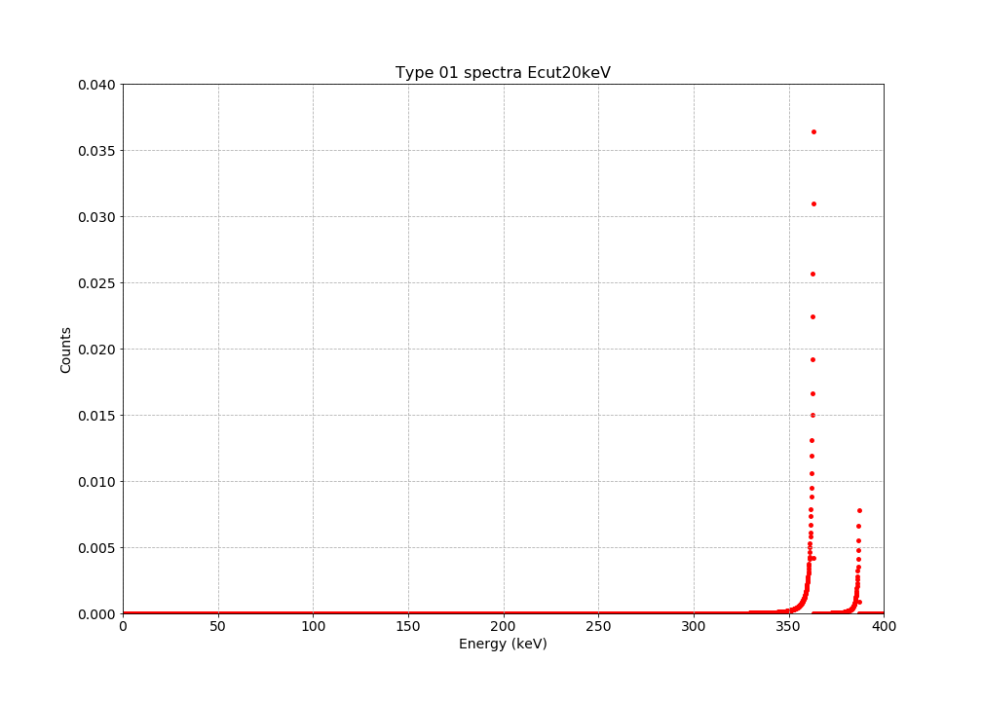
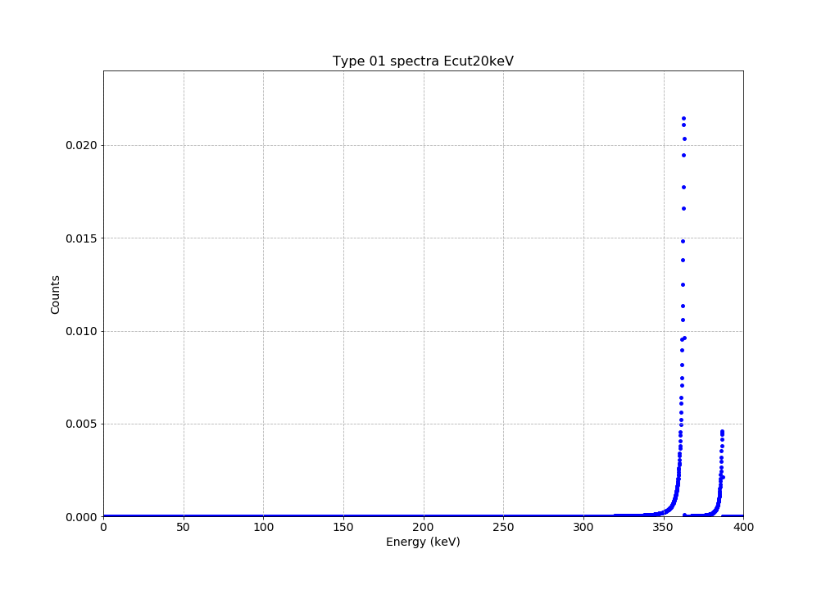
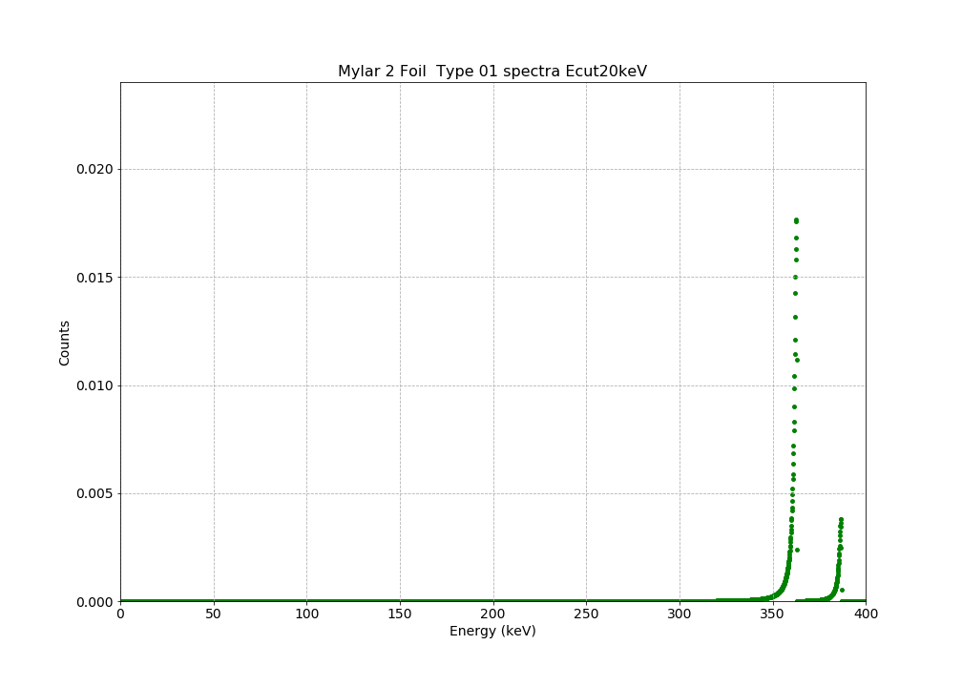
Geant4 simulations results for ¹¹³Sn electron conversion
Source holder : Mylar
0- Foil
1- Foil
B_{z}$=0.6 T$
$$\vec{B}=1(T)\hat{z}$$
B_{z}$=0.6 T$
B_{z}$=0.6 T$
$$\vec{B}=1(T)\hat{z}$$
B_{z}$=0.6 T$
0- Foil
1- Foil
2- Foil
B_{z}$=0.6 T$
$$\vec{B}=1(T)\hat{z}$$
B_{z}$=0.6 T$
2- Foil
Fig: The simulated spectra for electron conversion for ¹¹³Sn with different foil configurations of 0,1,2 foils with the source holder made of mylar
APS April 2023 R.Gupta 10

Slide 13
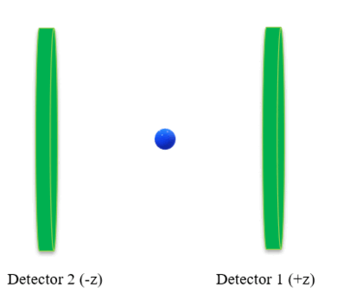
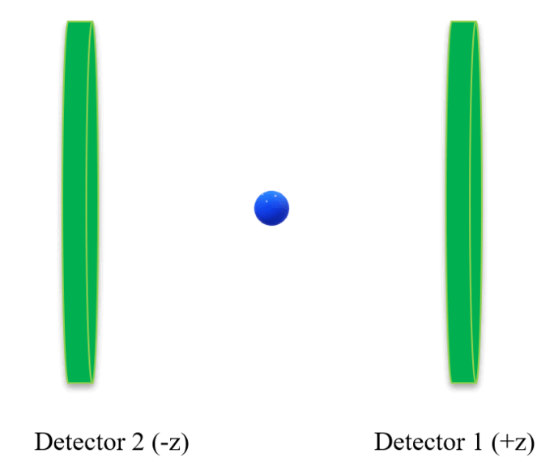


Classification of events
TYPE 0 : Direct Events
TYPE 1 : Backscattered Events
Detector 2
(-z)
Detector 1
(+z)
Fig: Schematic representation of differentiating between possible types of events as the direct or back-scattered events
Observe how the reconstructed energy spectra changes by varying the energy threshold of the detector 1 from 10 keV to 100 keV in the step-size of 10 keV for different geometries.
5
APS April 2023 R.Gupta 11

Slide 14
UCNA+ simulation results for backscattering systematics
Geant4 Version :
Physics model : standard model
Change in ratios
Pitch angle distribution for back-scattered events
Change in average energy deposition with time of flight
APS April 2023 R.Gupta 12

Slide 15
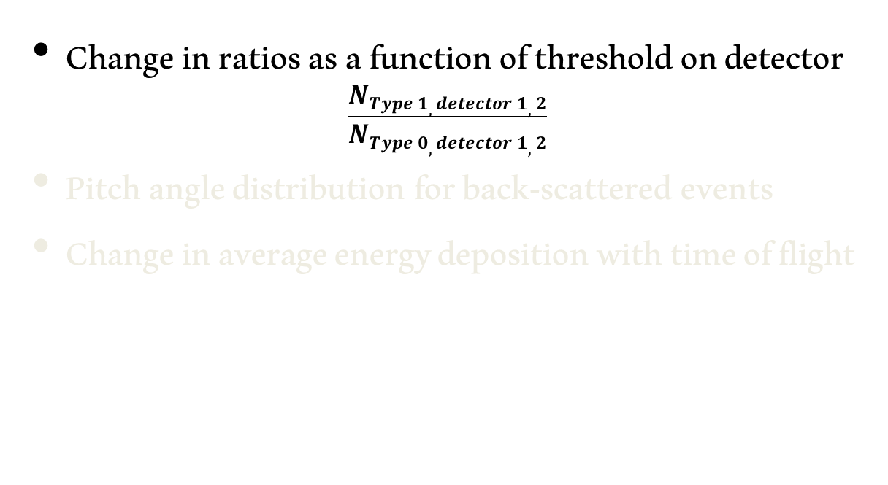
UCNA+ simulation results for backscattering systematics
Type 0,detector 1
Type 1,detector 1
Detector 2
(-z)
Detector 1
(+z)
Change in ratios as a function of threshold on detector
$$\frac{NType 1, detector 1,2}{NType 0, detector 1,2}$$
Pitch angle distribution for back-scattered events
Change in average energy deposition with time of flight
APS April 2023 R.Gupta 12

Slide 16
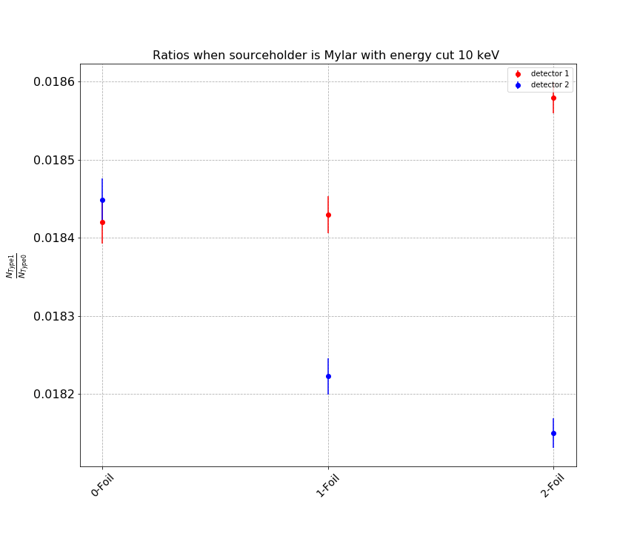
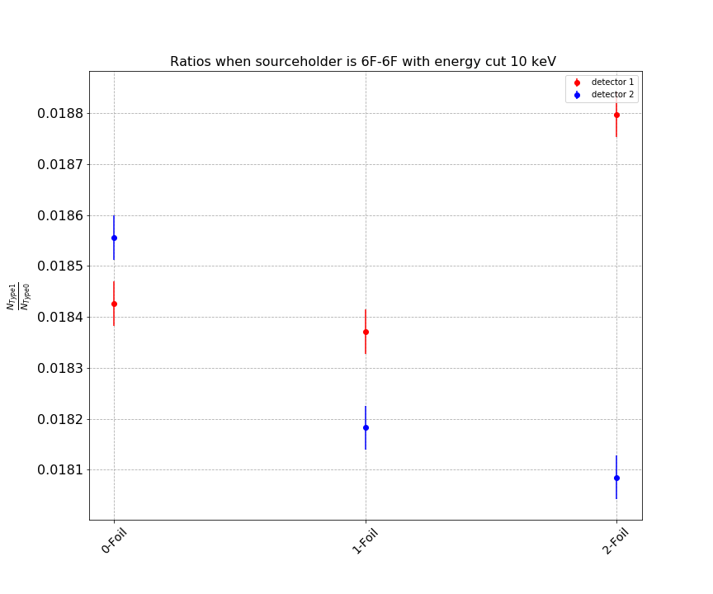
Comparison of change in ratios
for different endcap foil configuration and different source holder with different threshold values
The ratio of the backscattering to direct event is ~ 1.8 %
Increases (decreases) with increase in number of foils for detector 1 (2)
The ratio comes closer with increase in the threshold value of the detector.
Fig : Geant4 simulations results for change in ratio of the back-scattered events to the direct events for the different foil configurations placed in front of the detector 1 along the +z axis. We compare the results for different source holder made of Mylar of thickness 0.5 micron and sixFsixF of thickness 120 nm for different detector threshold values
APS April 2023 R.Gupta 13
Notes:
Mention the number of decays
Can measure 500 decays per sec

Slide 17
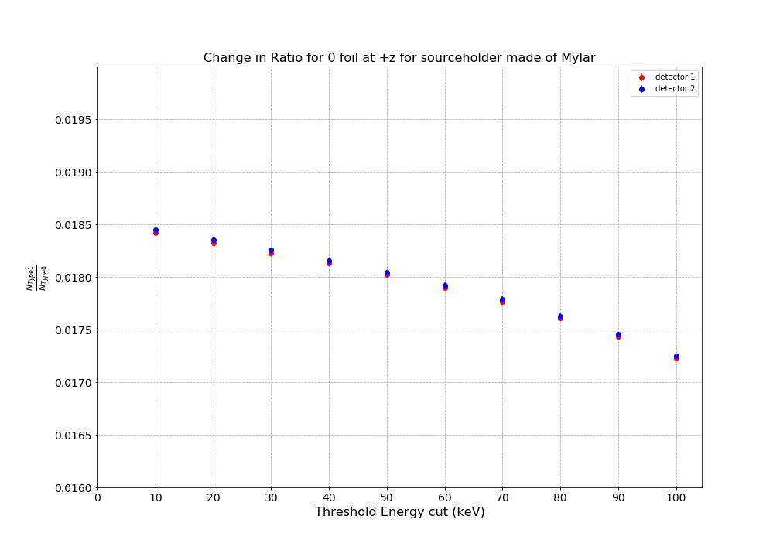
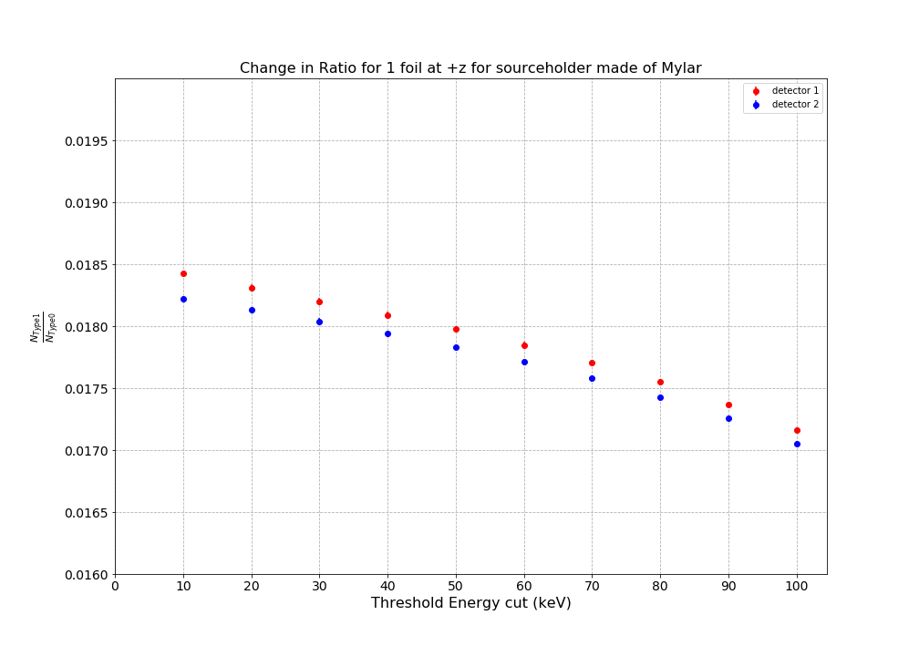
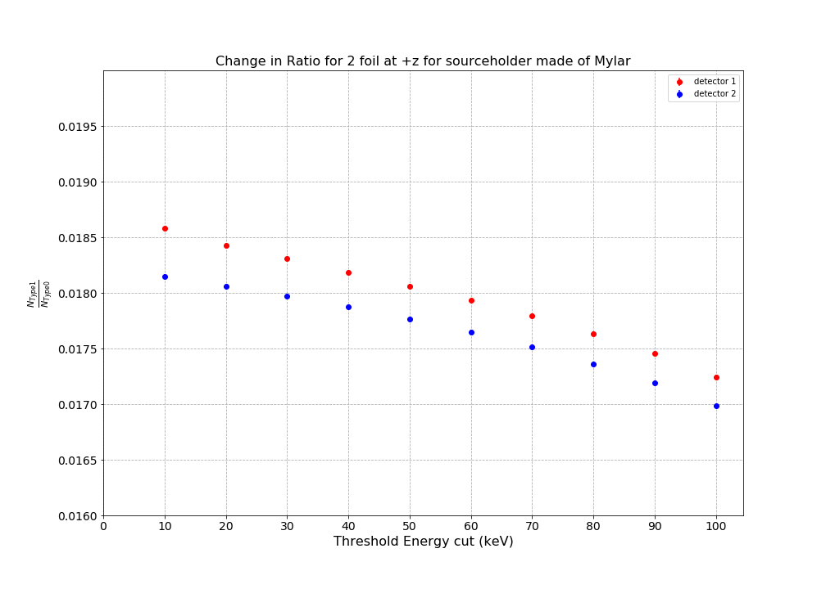
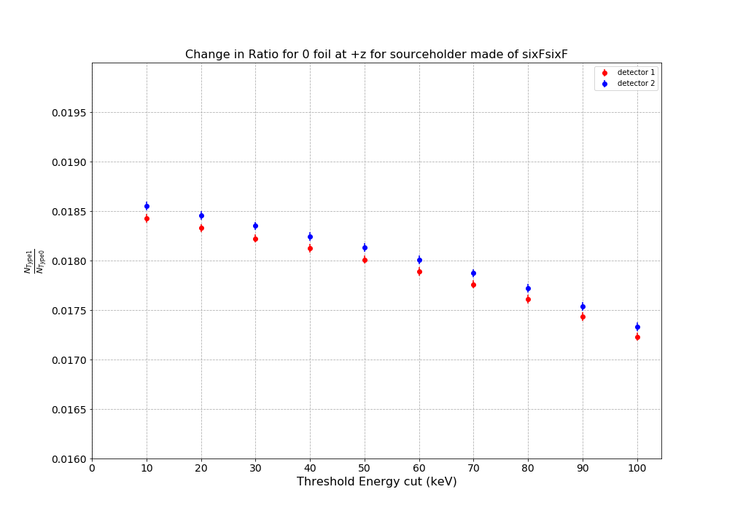
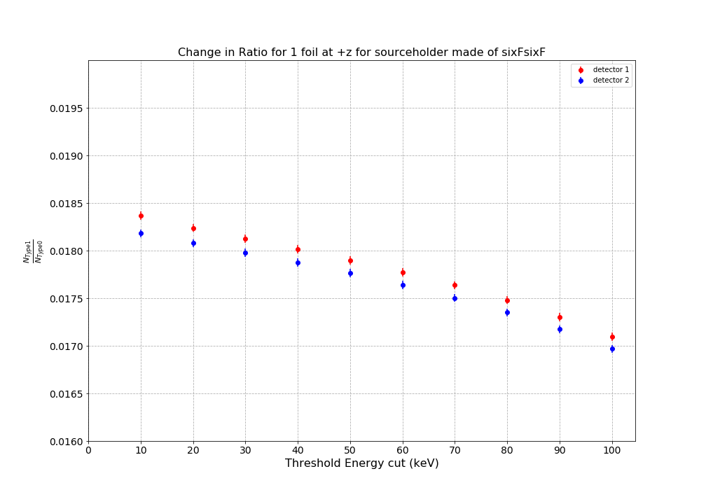
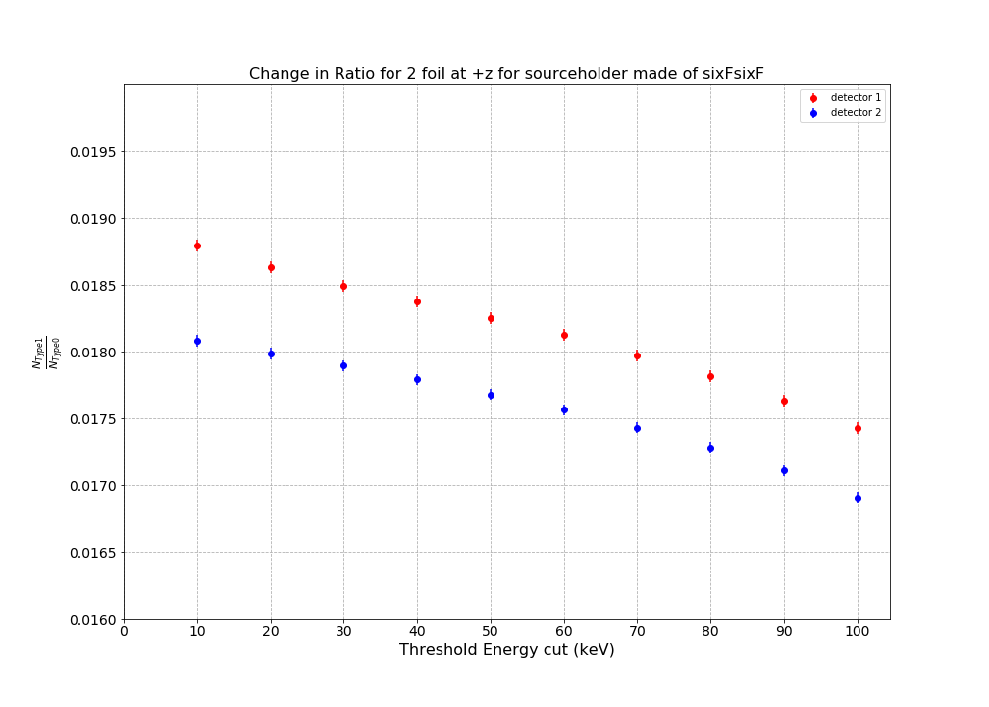
Comparison of change in ratios
for different endcap foil configuration with different threshold values
source holder : Mylar
source holder : sixFsixF
Fig : Geant4 simulations results for change in ratio of the back-scattered events to the direct events for the different foil configurations placed in front of the detector 1 along the +z axis for different detector threshold values. We compare the results for different source holder made of Mylar of thickness 0.5 micron and sixFsixF of thickness 120 nm.
APS April 2023 R.Gupta 14

Slide 18
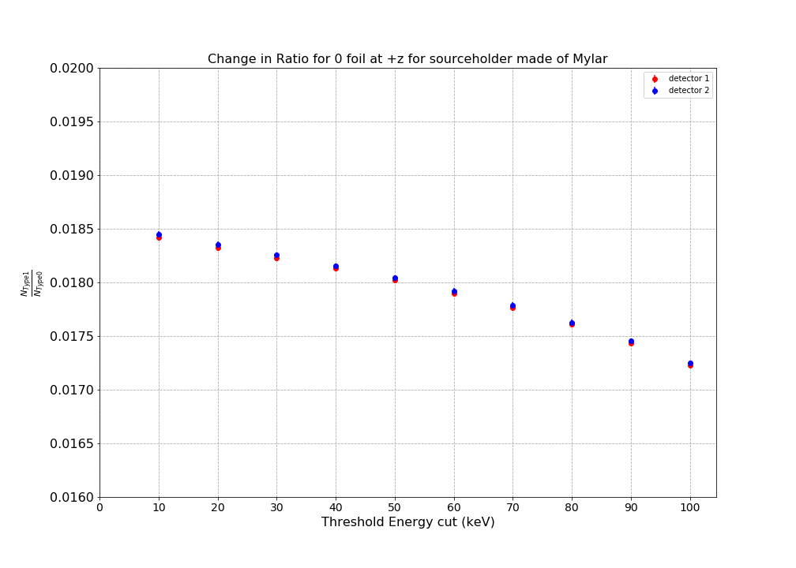
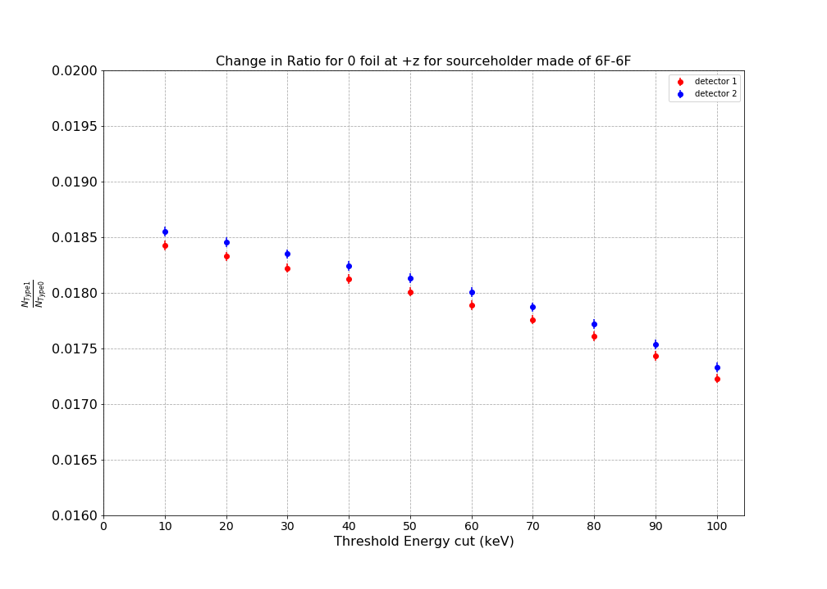
Comparison of change in ratios
for different endcap foil configuration with different threshold values
The ratio of the backscattering to direct event decreases by ~1% from 1.8 % to 1.7 % with increase in the threshold value
The ratios for detector 1 and 2 move apart more with increase in number of foils more so for sixFsixF.
Fig : Geant4 simulations results for change in ratio of the back-scattered events to the direct events for the different foil configurations placed in front of the detector 1 along the +z axis for different detector threshold values. We compare the results for different source holder made of Mylar of thickness 0.5 micron and sixFsixF of thickness 120 nm.
APS April 2023 R.Gupta 15

Slide 19
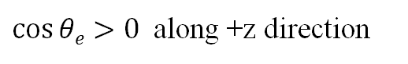
UCNA+ simulation results for backscattering systematics
$\cos{θe}>0$ along +z direction
Change in ratios
Pitch angle distribution for back-scattered events
Change in average energy deposition with time of flight
APS April 2023 R.Gupta 16

Slide 20
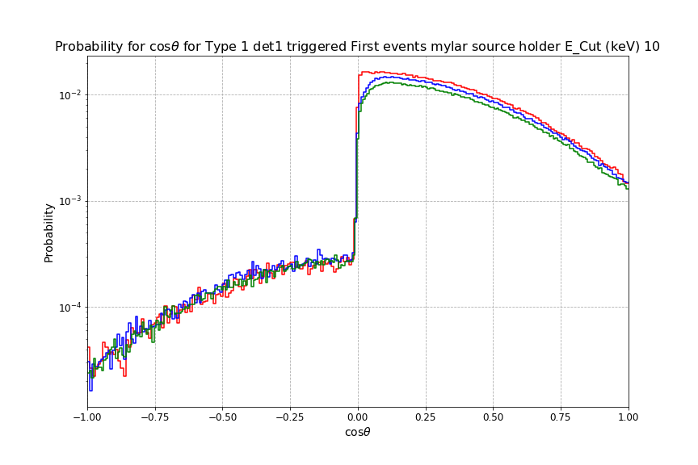
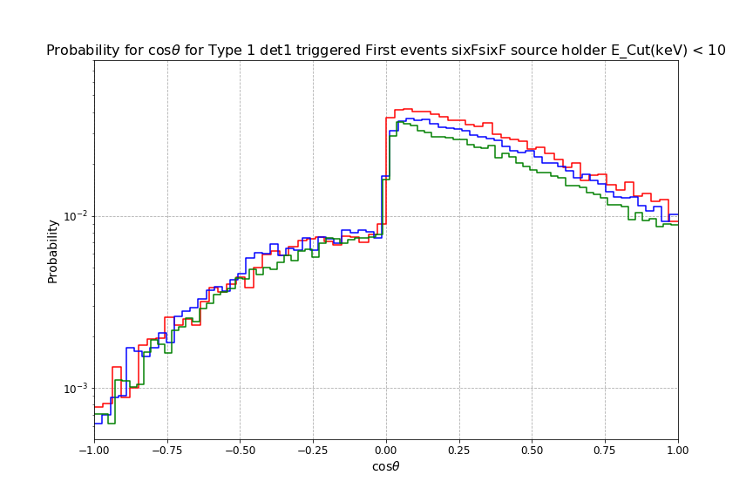
Comparison of change in angular distribution
for different endcap foil configuration and different source holder with different threshold values
Back-scattering increases, as the pitch angle increases.
There is a finite probability for the electrons to be multi-scattered and, is more when the source holder is made of sixFsixF
- 0-Foil
- 1-Foil
- 2-Foil
- 0-Foil
- 1-Foil
- 2-Foil
Fig : Geant4 simulations results for change in pitch angle distribution for the back-scattered events that hit the detector 1 first. first . The analysis is done for the different foil configurations placed in front of the detector 1 along the +z axis for different detector threshold values. We compare the results for different source holder made of Mylar of thickness 0.5 micron and sixFsixF of thickness 120 nm.
APS April 2023 R.Gupta 17

Slide 21
UCNA+ simulation results for backscattering systematics
E₂
E₁
Change in ratios
Pitch angle distribution for back-scattered events
Change in average energy deposition with time of flight
APS April 2023 R.Gupta 18

Slide 22
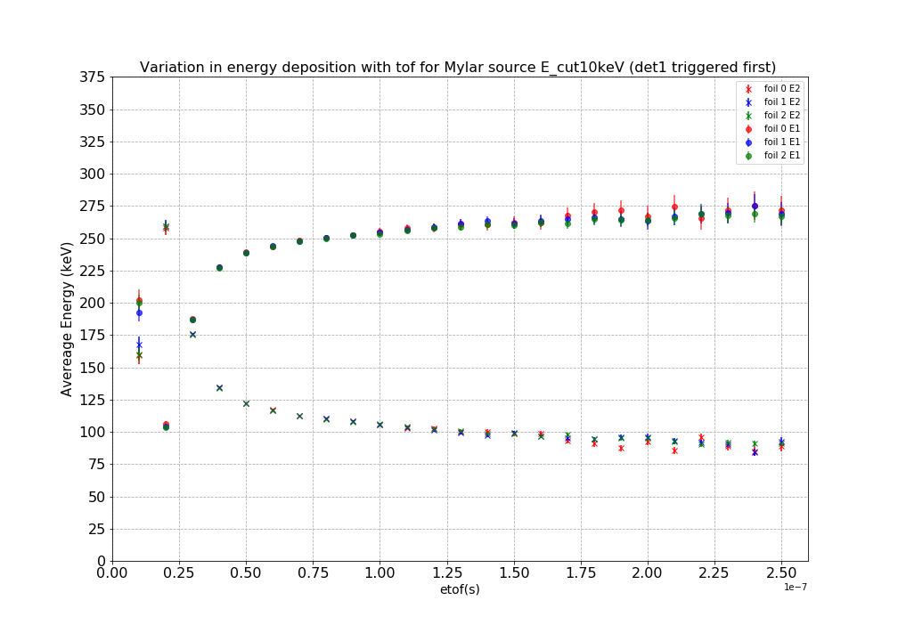
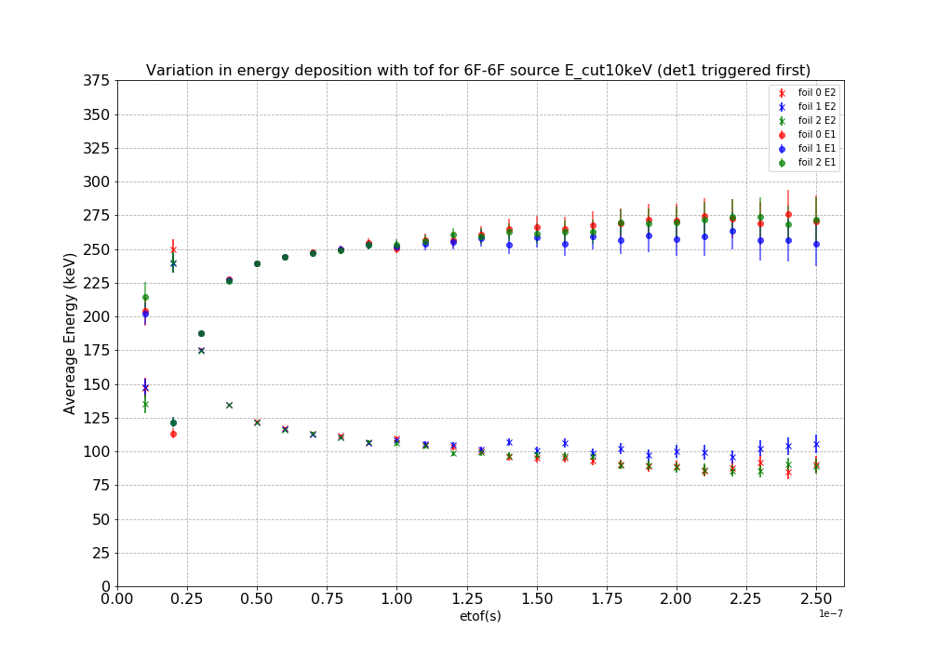
Comparison of change in E_{avg} in the detector with time of flight
for different endcap foil configuration and different source holder with different threshold values
E_{avg} deposited in detector 1 (triggered first) increases with increase in time of flight from 25 ns – 125 ns after which it becomes roughly constant to 275 keV
Shift with 10%-20% for higher threshold values
Fig : Geant4 simulations results for change E_{avg} detector with the time of flight for the back-scattered events that hit the detector 1 first . The analysis is done for the different foil configurations placed in front of the detector 1 along the +z axis for different detector threshold values. We compare the results for different source holder made of Mylar of thickness 0.5 micron and sixFsixF of thickness 120 nm.
APS April 2023 R.Gupta 19
Notes:
Coupled directly to multiscattering

Slide 23
Comparison of change in E_{avg} in the detector with time of flight
for different endcap foil configuration and different source holder with different threshold values
E_{avg} deposited in detector 1 (triggered first) increases with increase in time of flight from 25 ns – 125 ns after which it becomes roughly constant to 275 keV
Shift with 10%-20% for higher threshold values
Energy deposited in detector 1
Fig : Geant4 simulations results for change E_{avg} detector with the time of flight for the back-scattered events that hit the detector 1 first . The analysis is done for the different foil configurations placed in front of the detector 1 along the +z axis for different detector threshold values. We compare the results for different source holder made of Mylar of thickness 0.5 micron and sixFsixF of thickness 120 nm.
APS April 2023 R.Gupta 19
Notes:
Coupled directly to multiscattering

Slide 24
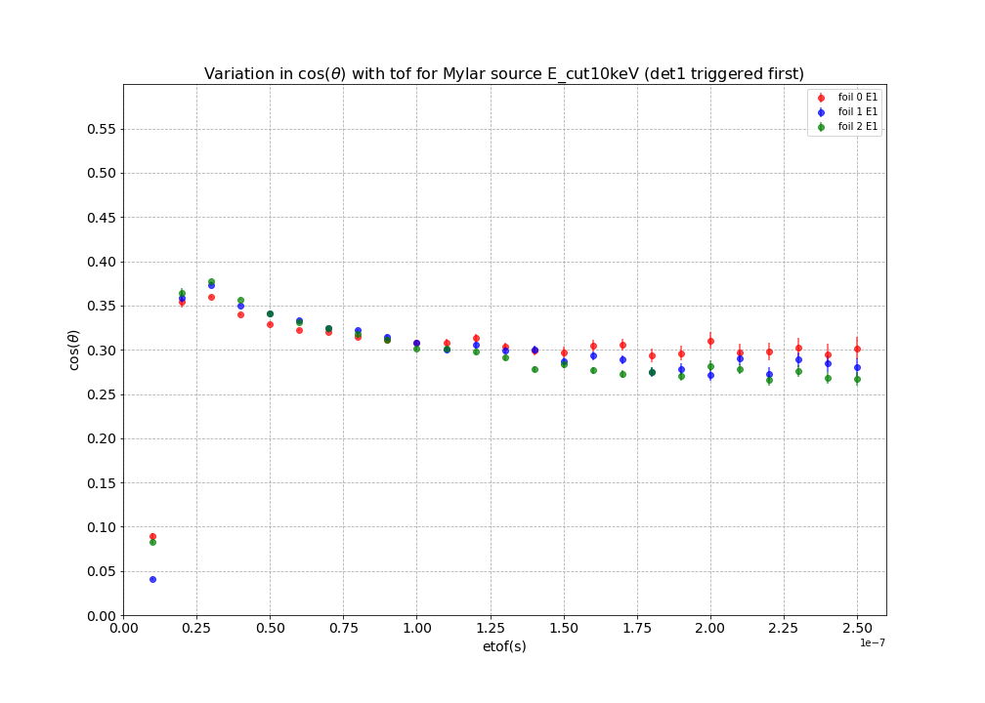
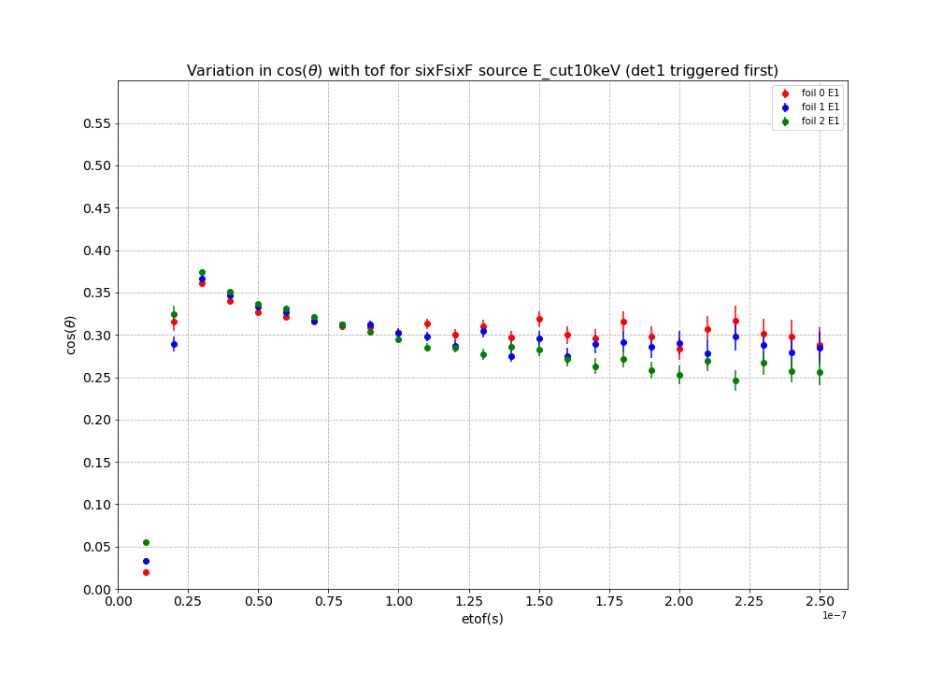
Relation between time of flight and the pitch angle for Type 1 events
The pitch angle distribution becomes flatter with increase in threshold of the detector
Larger pitch angle corresponds to smaller time of flight indicating multiple back-scattering
Fig : Geant4 simulations results for change in the pitch angle with the time of flight for the back-scattered events that hit the detector 1 first . The analysis is done for the different foil configurations placed in front of the detector 1 along the +z axis for different detector threshold values. We compare the results for different source holder made of Mylar of thickness 0.5 micron and sixFsixF of thickness 120 nm.
APS April 2023 R.Gupta 20
Notes:
Are small effects seek to measure below 10% precision levels

Slide 25
SUMMARY
The ability to model integrated backscatter fractions for 1 and 2 decay trap foils and for two different foil thicknesses were investigated.
The pitch angle and energy distributions were explored using E vs. delta T (time of flight).
Absolute sensitivity of the measurements was probed using threshold scaling.
Future Work
Test physics models with Geant4.
Investigate events when foils are placed in field expansion region.
Explore source energy selection.
This material is based upon work supported by the U.S. Department of Energy, Office of Science, Office of Nuclear Physics, under Award Number DE-SC0 014622
APS April 2023 R.Gupta
Notes:
Can have one set of measurements using 0.5 micron

Slide 26



Collaboration (from Maninder)
APS April 2023 R.Gupta

Slide 27
BACK UP SLIDES

Slide 28
Geant4 representation of the geometry
3
Fig : Geant4 simulations representation for UCNA+ experiment
APS April 2023 R.Gupta 4

Slide 29

Classification of events
TYPE 0 : Direct Events
TYPE 1 : Backscattered Events
Detector 2
(-z)
Detector 1
(+z)
Fig: Schematic representation of differentiating between possible types of events as the direct or back-scattered events
2 Rashika Gupta
5

Slide 30
Type 0 events
Classification of events
Fig: Schematic representation of type 0 events.

Slide 31
Classification of events
Type 1 events
Fig: Schematic representation of type 1 events.

Slide 32
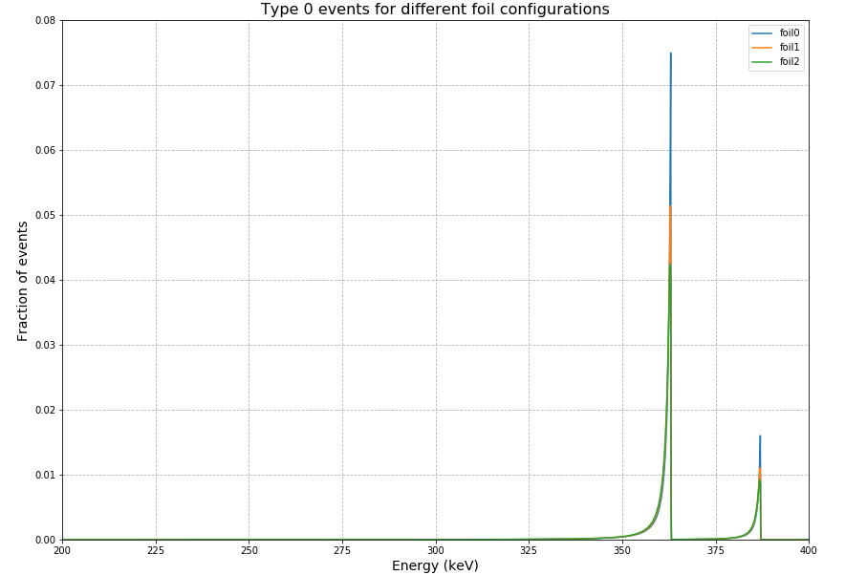

Geant4 simulations results for ¹¹³Sn electron conversion
B_{z}$=0.6 T$
$$\vec{B}=1(T)\hat{z}$$
B_{z}$=0.6 T$
B_{z}$=0.6 T$
$$\vec{B}=1(T)\hat{z}$$
B_{z}$=0.6 T$
B_{z}$=0.6 T$
$$\vec{B}=1(T)\hat{z}$$
B_{z}$=0.6 T$

Slide 33
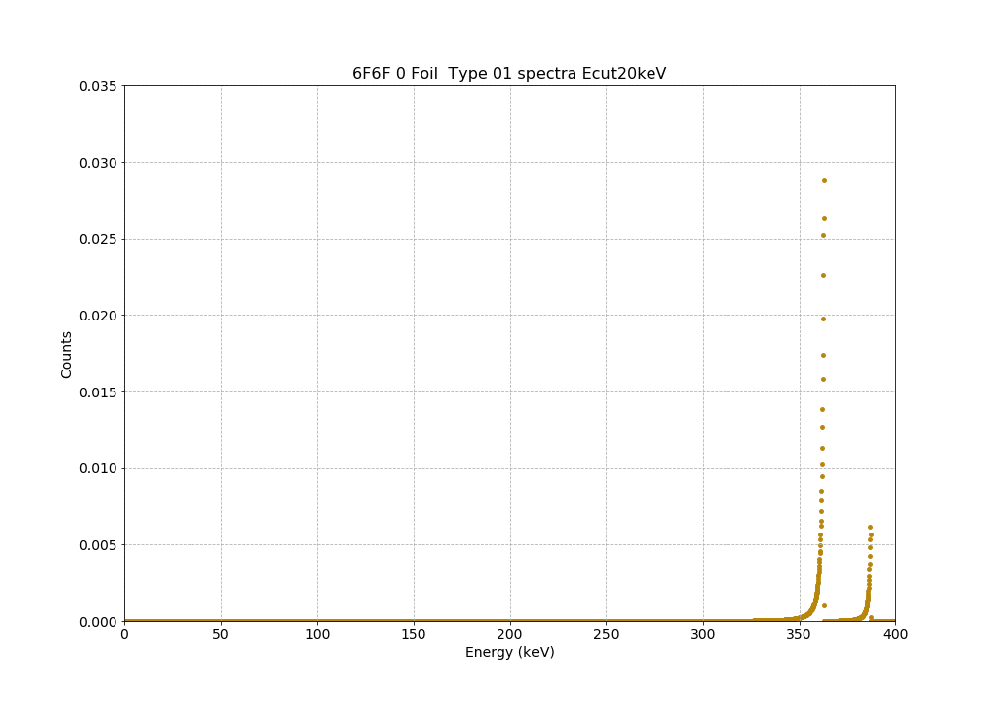
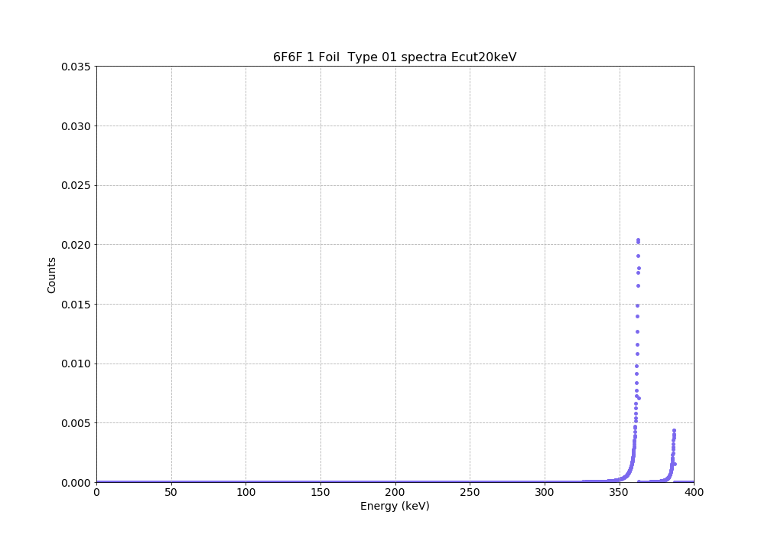

Geant4 simulations results for ¹¹³Sn electron conversion
Source holder : 6F-6F
0- Foil
1- Foil
B_{z}$=0.6 T$
$$\vec{B}=1(T)\hat{z}$$
B_{z}$=0.6 T$
B_{z}$=0.6 T$
$$\vec{B}=1(T)\hat{z}$$
B_{z}$=0.6 T$
0- Foil
1- Foil
2- Foil
B_{z}$=0.6 T$
$$\vec{B}=1(T)\hat{z}$$
B_{z}$=0.6 T$
2- Foil
Fig: The simulated spectra for electron conversion for ¹¹³Sn with different foil configurations of 0,1,2 foils with the source holder made of sixFsixF.
APS April 2023 R.Gupta 10

